Slide 1
Introduction
Javascript and GIT
Notes:
Introductions
Team agreements
Recap from last week

Slide 2
At the end of the week
Introduction to JavaScript
Introduction to GIT
Introduction to Bootstrap
Responsive Design and Media Queries
GitHub Pages
Fundamentals of JavaScript

Slide 3

Expectations

Slide 4
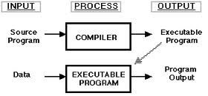
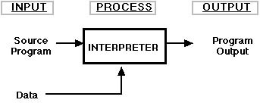
Introduction to JavaScript
Set up tools
VsCode
JavaScript is an interpreted language
Notes:
Interpreters translate high level programming instructions into intermediate codes and then execute the resulting codes. Compilers translate high level programming language codes into the object codes. Interpreters execute code line by line, whereas compilers execute the resulting files.

Slide 5
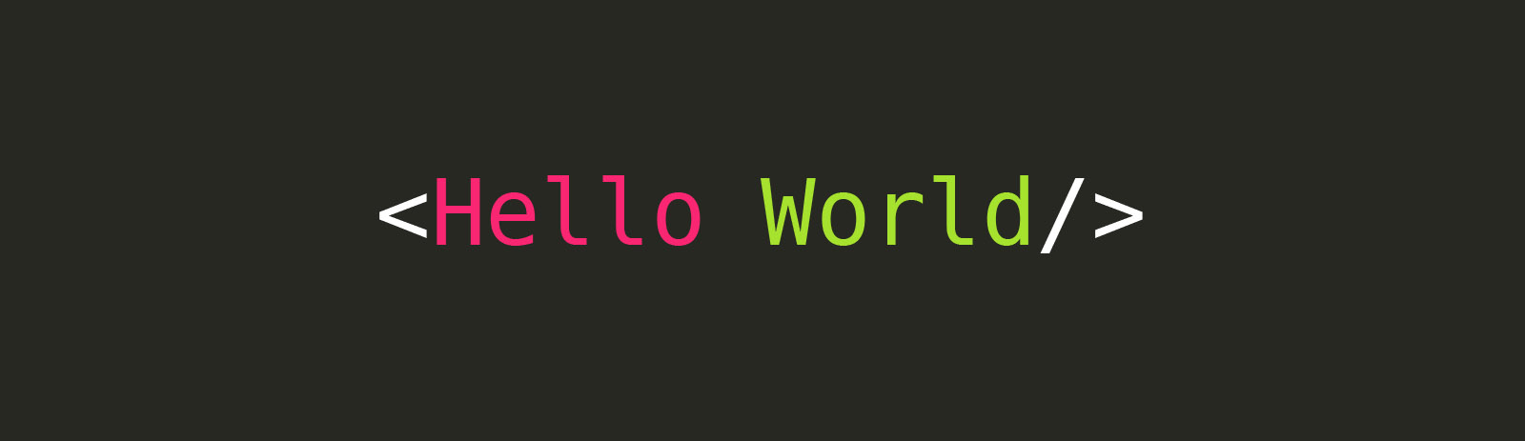
Hands on session

Slide 6
What can you do with JavaScript?
Website and Web Applications
Server applications
Mobile Applications
Notes:
https://www.grandcircus.co/blog/10-things-you-can-build-with-javascript/

Slide 7
Introduction to GIT
What is version control?
Importance of Version control.
What is GIT and how does it work?
Notes:
The management of changes to documents, computer programs, large web sites, and other collections of information.
Git is an open-source version control system that was started by Linus Trovalds—the same person who created Linux. Git is similar to other version control systems—Subversion, CVS, and Mercurial to name a few.

Slide 8
GitHub and BitBucket
These are large ‘stores’ of projects.
Repositories
Forking
Pull Requests
ToDo
Set Up GIT
Create Github accounts
Commit our changes

Slide 9



Retrospective

